Slide 1
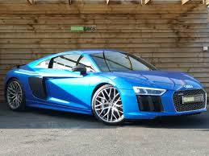
CARS
A SLIDE SHOW ALL ABOUT CARS
A JAYB1305 PRODUCTION
BY JAYDEN BROWN

Slide 2
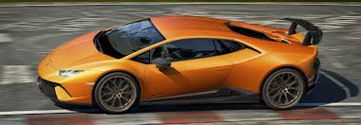
BEFOR CARS
In the beginning, a man walked. Really, there wasn’t any choice. In fact, 100,000 years ago, walking was more unpleasant that you could imagine. Instead of shoes, primitive men had rudimentary sandals made out of animal skin and plant fiber. There were no roads. The best they had were dirt paths worn into the ground by years of travel. Lucky for them, or rather, their descendants, things would eventually improve. In the beginning, a man walked. Really, there wasn’t any choice. In fact, 100,000 years ago, walking was more unpleasant that you could imagine. Instead of shoes, primitive men had rudimentary sandals made out of animal skin and plant fiber. There were no roads. The best they had were dirt paths worn into the ground by years of travel. Lucky for them, or rather, their descendants, things would eventually improve.

Slide 3
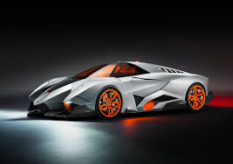
In approximately 3500 BC, in what is no modern day Iraq, the wheel was invented. The first wheels were made out of wood. This lead to the development of roads and eventually chariots.Things cooled off for several thousand years until the 17th century when all kinds of hot new discoveries began gracing the globe. With the advent of steam and coal power we had the invention of boats which did not require sails. We also applied manpower to get ourselves around with a little invention known as the bicycle. By the mid-19thcentury we were shrinking continents and countries (England in particular) using railroads. They provided the fastest, most reliable transportation ever seen. Best of all, they could transport massive quantities of goods. The first railway opened in the 1830s

Slide 4
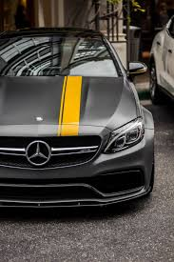
At the turn of the century, motor vehicles were handmade, expensive toys of the rich, and widely regarded as rare and dangerous. When the first electric car emerged in Britain in the 19th century, the speed limit was set at four miles an hour so a man could run ahead with a flag, warning citizens of the oncoming menace. Things changed dramatically in 1908 when Henry Ford released the first Model T. Suddenly a car was affordable, and a fast one, too: The Model T could zoom up to 45 miles an hour. Middle-class families scooped them up, mostly in cities, and as they began to race through the streets, they ran headlong into pedestrians—with lethal results. By 1925, auto accidents accounted for two-thirds of the entire death toll in cities with populations over 25,000.An outcry arose, aimed squarely at drivers. The public regarded them as murderers. Walking in the streets? That was normal. Driving? Now that was aberrant—a crazy new form of selfish behavior.

Slide 5
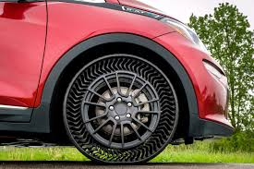
“Nation Roused Against Motor Killings” read the headline of a typical New York Times story, decrying “the homicidal orgy of the motor car.” The editorial went on to quote a New York City traffic court magistrate, Bruce Cobb, who exhorted, “The slaughter cannot go on. The mangling and crushing cannot continue.” Editorial cartoons routinely showed a car piloted by the grim reaper, mowing down innocents.When Milwaukee held a “safety week” poster competition, citizens sent in lurid designs of car accident victims. The winner was a drawing of a horrified woman holding the bloody corpse of her child. Children killed while playing in the streets were particularly mourned. They constituted one-third of all traffic deaths in 1925; half of them were killed on their home blocks. During New York’s 1922 “safety week” event, 10,000 children marched in the streets, 1,054 of them in a separate group symbolizing the number killed in accidents the previous year.Drivers wrote their own letters to newspapers, pleading to be understood. “We are not a bunch of murderers and cutthroats,” one said. Yet they were indeed at the center of a fight that, clearly, could only have one winner. To whom should the streets belong?

Slide 6
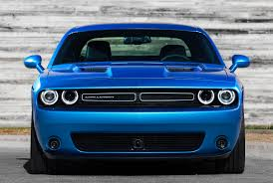
By the early 1920s, anti-car sentiment was so high that carmakers and driver associations—who called themselves “motordom”—feared they would permanently lose the public.
You could see the damage in car sales, which slumped by 12 percent between 1923 and 1924, after years of steady increase. Worse, anti-car legislation loomed: Citizens and politicians were agitating for “speed governors” to limit how fast cars could go. “Gear them down to fifteen or twenty miles per hour,” as one letter-writer urged. Charles Hayes, president of the Chicago Motor Club, fretted that cities would impose “unbearable restrictions” on cars.
Hayes and his car-company colleagues decided to fight back. It was time to target not the behavior of cars—but the behavior of pedestrians. Motordom would have to persuade city people that, as Hayes argued, “the streets are made for vehicles to run upon”—and not for people to walk. If you got run over, it was your fault, not that of the motorist. Motordom began to mount a clever and witty public-relations campaign.

Slide 7
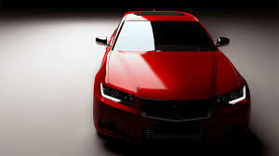
Their most brilliant stratagem: To popularize the term “jaywalker.” The term derived from “jay,” a derisive term for a country bumpkin. In the early 1920s, “jaywalker” wasn’t very well known. So pro-car forces actively promoted it, producing cards for Boy Scouts to hand out warning pedestrians to cross only at street corners. At a New York safety event, a man dressed like a hayseed was jokingly rear-ended over and over again by a Model T. In the 1922 Detroit safety week parade, the Packard Motor Car Company produced a huge tombstone float—except, as Norton notes, it now blamed the jaywalker, not the driver: “Erected to the Memory of Mr. J. Walker: He Stepped from the Curb Without Looking.”
The use of “jaywalker” was a brilliant psychological ploy. What’s the best way to convince urbanites not to wander in the streets? Make the behavior seem unsophisticated—something you’d expect from hicks fresh off the turnip truck. Car companies used the self-regarding snobbery of city-dwellers against themselves. And the campaign worked. Only a few years later, in 1924, “jaywalker” was so well-known it appeared in a dictionary: “One who crosses a street without observing the traffic regulations for pedestrians.”
Meanwhile, newspapers were shifting allegiance to the automakers—in part, Norton and Vanderbilt argue, because they were profiting heavily from car ads. So they too began blaming pedestrians for causing accidents.

Slide 8
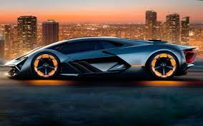
“It is impossible for all classes of modern traffic to occupy the same right of way at the same time in safety,” as the Providence Sunday Journal noted in a 1921 article called “The Jay Walker Problem,” reprinted from the pro-car Motor magazine.
In retrospect, you could have predicted that pedestrians were doomed. They were politically outmatched. “There was a road lobby of asphalt users, but there was no lobby of pedestrians,” Vanderbilt says. And cars were a genuinely useful technology. As pedestrians, Americans may have feared their dangers—but as drivers, they loved the mobility.
By the early ’30s, the war was over. Ever after, “the street would be monopolized by motor vehicles,” Norton tells me. “Most of the children would be gone; those who were still there would be on the sidewalks.” By the 1960s, cars had become so dominant that when civil engineers made the first computer models to study how traffic flowed, they didn’t even bother to include pedestrians.

Slide 9
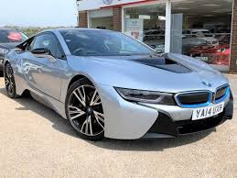
The triumph of the automobile changed the shape of America, as environmentalists ruefully point out. Cars allowed the suburbs to explode, and big suburbs allowed for energy-hungry monster homes. Even in midcentury, critics could see this coming too. “When the American people, through their Congress, voted for a twenty-six-billion-dollar highway program, the most charitable thing to assume is that they hadn’t the faintest notion of what they were doing,” Lewis Mumford wrote sadly in 1958.

Slide 10
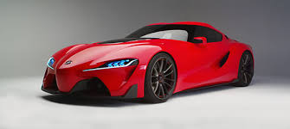
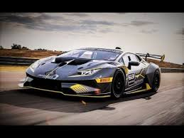
Cars of today
Cars have controls for driving, parking, passenger comfort, and a variety of lights. Over the decades, additional features and controls have been added to vehicles, making them progressively more complex, but also more reliable and easier to operate.^{[citation needed]} These include rear reversing cameras, air conditioning, navigation systems, and in-car entertainment. Most cars in use in the 2010s are propelled by an internal combustion engine, fueled by the combustion of fossil fuels. Electric cars, which were invented early in the history of the car, began to become commercially available in 2008.

Slide 11
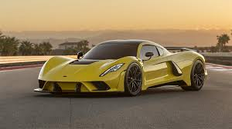
Fast cars Of TODAY
CAR | CAR NAME | M/H | Colour
Ferrari | La Ferrari | 217mph | Red
Lamborghini | Veneto | 220mph | Red
Dodge | Demon | 195mph | Black
Audi | R8 | 244mph | Blue
McLaren | 720S | 250mph | White
Mercedes-Benz | SLS AMG Kleemann | 221mph | Silver
Bugatti | Veyron Super Sport | 267mph | Black
Range Rover | Sport SVR | 174mph | Blue
Lotus | Wingless EvoroGT430 Sport | 196mph | Red
Bentley | Continental SuperSport Convertable | 202mph | Green

Slide 12
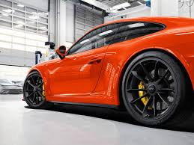
There are costs and benefits to car use. The costs to the individual include acquiring the vehicle, interest payments (if the car is financed), repairs and maintenance, fuel, depreciation, driving time, parking fees, taxes, and insurance.^{[4]} The costs to society include maintaining roads, land use, road congestion, air pollution, public health, health care, and disposing of the vehicle at the end of its life. Traffic collisionsare the largest cause of injury-related deaths worldwide.^{[5]}
The personal benefits include on-demand transportation, mobility, independence, and convenience.^{[6]}The societal benefits include economic benefits, such as job and wealth creation from the automotive industry, transportation provision, societal well-being from leisure and travel opportunities, and revenue generation from the taxes. People's ability to move flexibly from place to place has far-reaching implications for the nature of societies.^{[7]} There are around 1 billion cars in use worldwide. The numbers are increasing rapidly, especially in China, India and other newly industrialized countries.^{[8]}

Slide 13
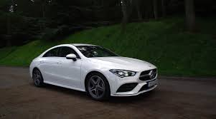
The word car is believed to originate from the Latin word carrus or carrum ("wheeled vehicle"), or the Middle English word carre (meaning "two-wheel cart", from Old North French). In turn, these originated from the Gaulish word karros (a Gallic chariot).^{[9][10]} It originally referred to any wheeled horse-drawn vehicle, such as a cart, carriage, or wagon.^{[11][12]} "Motor car" is attested from 1895, and is the usual formal name for cars in British English.^{[3]} "Autocar" is a variant that is also attested from 1895, but that is now considered archaic. It literally means "self-propelled car".^{[13]} The term "horseless carriage" was used by some to refer to the first cars at the time that they were being built, and is attested from 1895.^{[14]}

Slide 14
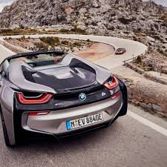
The word "automobile" is a classical compound derived from the Ancient Greek word autós (αὐτός), meaning "self", and the Latin word mobilis, meaning "movable". It entered the English language from French, and was first adopted by the Automobile Club of Great Britain in 1897.^{[15]} Over time, the word "automobile" fell out of favour in Britain, and was replaced by "motor car". "Automobile" remains chiefly North American, particularly as a formal or commercial term.^{[16]} An abbreviated form, "auto", was formerly a common way to refer to cars in English, but is now considered old-fashioned. The word is still very common as an adjective in American English, usually in compound formations like "auto industry" and "auto mechanic".^{[17][18]} In Dutch and German, two languages historically related to English, the abbreviated form "auto" (Dutch) / "Auto" (German), as well as the formal full version "automobiel" (Dutch) / "Automobil" (German) are still used — in either the short form is the most regular word for "car".

Slide 15
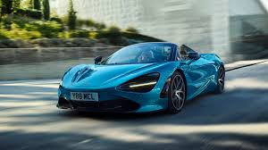
Most cars in use in the 2010s run on gasoline (petrol) burnt in an internal combustion engine (ICE). The International Organization of Motor Vehicle Manufacturers says that, in countries that mandate low sulfur gasoline, gasoline-fuelled cars built to late 2010s standards (such as Euro-6) emit very little local air pollution.^{[35][36]} Some cities ban older gasoline-fuelled cars and some countries plan to ban sales in future. However some environmental groups say this phase-out of fossil fuel vehicles must be brought forward to limit climate change. Some analysts say that production of gasoline fueled cars may have peaked and suggest the peak occurred in 2017^{[37]} or 2018.^{[38]}

Slide 16
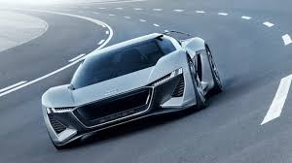
Other hydrocarbon fossil fuels also burnt by deflagration (rather than detonation) in ICE cars include diesel, Autogas and CNG. Removal of fossil fuel subsidies,^{[39][40]} concerns about oil dependence, tightening environmental laws and restrictions on greenhouse gas emissions are propelling work on alternative power systems for cars. This includes hybrid vehicles, plug-in electric vehicles and hydrogen vehicles. 2.1 million light electric vehicles (of all types but mainly cars) were sold in 2018, over half in China: this was an increase of 64% on the previous year, giving a global total on the road of 5.4 million.^{[41]}Vehicles using alternative fuels such as ethanol flexible-fuel vehicles and natural gas vehicles^{[clarification needed]} are also gaining popularity in some countries.^{[citation needed]} Cars for racing or speed records have sometimes employed jet or rocket engines, but these are impractical for common use.
Oil consumption has increased rapidly in the 20th and 21st centuries because there are more cars; the 1985–2003 oil glut even fuelled the sales of low-economy vehicles in OECD countries. The BRIC countries are adding to this consumption.

Slide 17
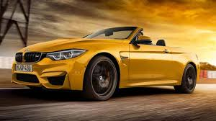
Cars are equipped with controls used for driving, passenger comfort and safety, normally operated by a combination of the use of feet and hands, and occasionally by voice on 21st century cars. These controls include a steering wheel, pedals for operating the brakes and controlling the car's speed (and, in a manual transmission car, a clutch pedal), a shift lever or stick for changing gears, and a number of buttons and dials for turning on lights, ventilation and other functions. Modern cars' controls are now standardised, such as the location for the accelerator and brake, but this was not always the case. Controls are evolving in response to new technologies, for example the electric car and the integration of mobile communications.

Slide 18
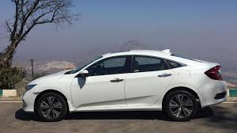
Some of the original controls are no longer required. For example, all cars once had controls for the choke valve, clutch, ignition timing, and a crank instead of an electric starter. However new controls have also been added to vehicles, making them more complex. These include air conditioning, navigation systems, and in car entertainment. Another trend is the replacement of physical knobs and switches by secondary controls with touchscreen controls such as BMW's iDrive and Ford's MyFord Touch. Another change is that while early cars' pedals were physically linked to the brake mechanism and throttle, in the 2010s, cars have increasingly replaced these physical linkages with electronic controls.

Slide 19
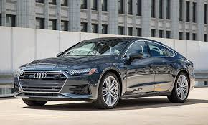
Cars are typically fitted with multiple types of lights. These include headlights, which are used to illuminate the way ahead and make the car visible to other users, so that the vehicle can be used at night; in some jurisdictions, daytime running lights; red brake lights to indicate when the brakes are applied; amber turn signal lights to indicate the turn intentions of the driver; white-coloured reverse lights to illuminate the area behind the car (and indicate that the driver will be or is reversing); and on some vehicles, additional lights (e.g., side marker lights) to increase the visibility of the car. Interior lights on the ceiling of the car are usually fitted for the driver and passengers. Some vehicles also have a trunk light and, more rarely, an engine compartment ligh

Slide 20
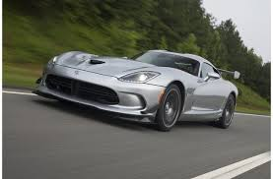
In the United States, "from 1975 to 1980, average [car] weight dropped from 1,842 to 1,464 kg (4,060 to 3,228 lb), likely in response to rising gasoline prices" and new fuel efficiencystandards.^{[43]} The average new car weighed 1,461 kg (3,221 lb) in 1987 but 1,818 kg (4,009 lb) in 2010, due to modern steel safety cages, anti-lock brakes, airbags, and "more-powerful—if more-efficient—engines."^{[44]}Heavier cars are safer for the driver from a crash perspective, but more dangerous for other vehicles and road users.^{[44]} The weight of a car influences fuel consumption and performance, with more weight resulting in increased fuel consumption and decreased performance. The SmartFortwo, a small city car, weighs 750–795 kg (1,655–1,755 lb). Heavier cars include full-size cars, SUVs and extended-length SUVs like the Suburban.

Slide 21
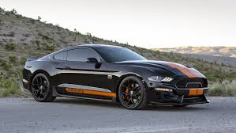
According to research conducted by Julian Allwood of the University of Cambridge, global energy use could be greatly reduced by using lighter cars, and an average weight of 500 kg (1,100 lb) has been said to be well achievable.^{[45][better source needed]} In some competitions such as the Shell Eco Marathon, average car weights of 45 kg (99 lb) have also been achieved.^{[46]} These cars are only single-seaters (still falling within the definition of a car, although 4-seater cars are more common), but they nevertheless demonstrate the amount by which car weights could still be reduced, and the subsequent lower fuel use (i.e. up to a fuel use of 2560 km/l).^{[47]}

Slide 22
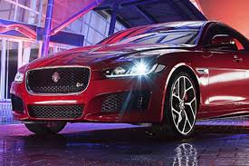
Most cars are designed to carry multiple occupants, often with four or five seats. Cars with five seats typically seat two passengers in the front and three in the rear. Full-size cars and large sport utility vehicles can often carry six, seven, or more occupants depending on the arrangement of the seats. On the other hand, sports cars are most often designed with only two seats. The differing needs for passenger capacity and their luggage or cargo space has resulted in the availability of a large variety of body styles to meet individual consumer requirements that include, among others, the sedan/saloon, hatchback, station wagon/estate, and minivan.

Slide 23
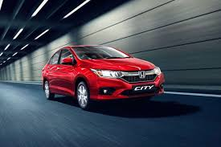
END

